Slide 1
Refrigeration of the western Cordilleran lithosphere during Laramide shallow-angle subduction
T. A. Dumitru., et al., 1991

Slide 2
Refrigeration
Thermal changes in lithosphere due to changes in subduction angle
Mechanics of change
Timing

Slide 3
Time Lag
Characteristic cooling time of lithosphere mainly depends on depth to top of subducting slab
T_{c}=$\frac{\sqrt{{thickness}^{2}}}{K}$
Sierra Nevada area is a favorable field site
WHERE
WHEN

Slide 4
Evidence
Following areas may contain evidence of Laramide refrigeration
Sierra Nevada
Great Basin
Mojave Desert and Western Arizona
Colorado Plateau

Slide 5
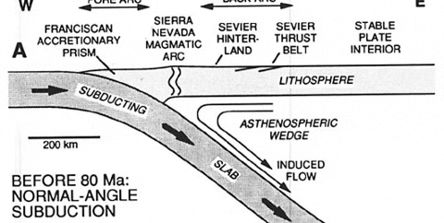
Sierra Nevada
Isotopic ages suggest thermal gradients were (50°C/Km) at 80my and stayed high for 5-10my
After 10my more years gradient decreased to a fifth of original
Thermal modeling: Top of subducting slab rose from 120 km pre laramide to 35 km laramide to account for the time lag.

Slide 6
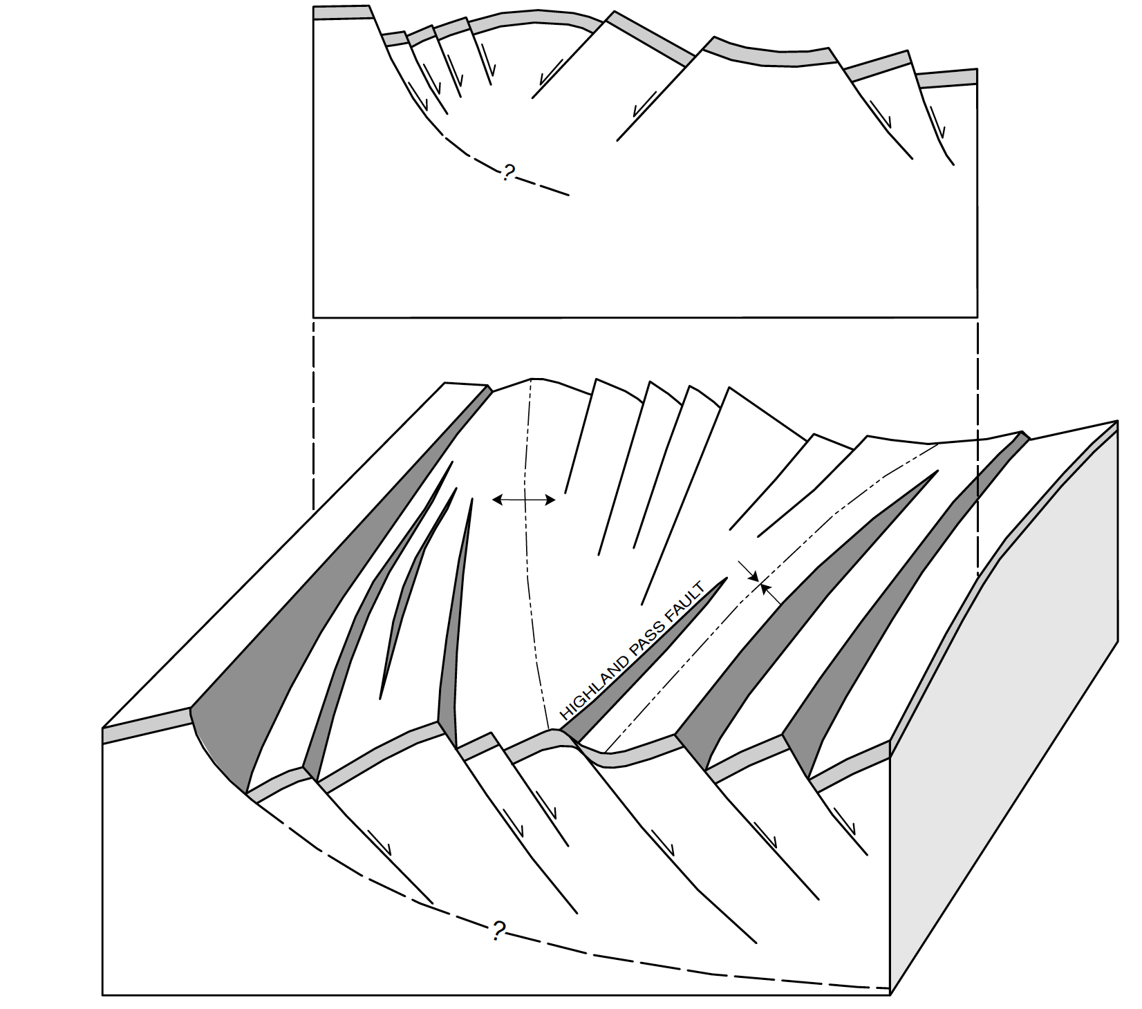
Great Basin
Crustal fault blocks can constrain thermal history
Previous work indicates peak temperatures were reached 90-70 Ma when miogeocline was flat
Schell Creek Range isotope data indicates that geothermal gradients lowered from 40-20°C/Km
Faulds et al., 2002

Slide 7
Mojave Desert and Western Arizona
SW Mojave: Hblnd closure temperatures reached 75 Ma, after emplacement of pluton
E Mojave: isotopic data data shows cooling around 65 Ma
Old Woman Mountains – Emplaced 73Ma, cooled (30°C/my) until 68 Ma, then cooled (10°C/my) until 60 Ma
Rapid cooling reflects reduced gradient, slow cooling reflects refrigeration

Slide 8
Colorado Plateau
Cooling of units near Phantom Ranch from 130°C to 40°C ~70Ma
Conclusions
Theoretically there should be refrigeration of the lithosphere, evidence in some places is great but very sparse.
Cretaceous-Tertiary cooling reflects decreased gradients not uplift and unroofing

Slide 9
References
Faulds, J.E., Olson, E.L., Harlan, S.S., and McIntosh, W.C., 2002, Miocene extension and fault-related folding in the Highland Range, southern Nevada: A three-dimensional perspective: Journal of Structural Geology, v. 24, p. 861-886.

